Slide 1
INTRODUCTION TO MOTORS

Slide 2
CONTENTS
• Discuss different types of motors and their uses
• H-bridge.
• Motor Driving Circuit.
• How to run motors in different Directions.
• Interfacing DC Geared Motor with Arduino.
• Voltage Regulator

Slide 3
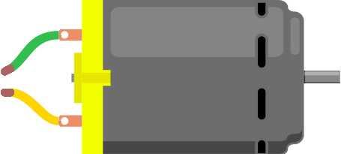
What is a motor?

Slide 4
Motors and actuators are the devices which make the robot movable. Motors and actuators convert electrical energy into physical motion.

Slide 5
Different types of motors
AC motor
Brushed DC motor
Brushless DC motor
Geared DC motor
Servo motor
Stepper motor
DC Linear Actuator

Slide 6
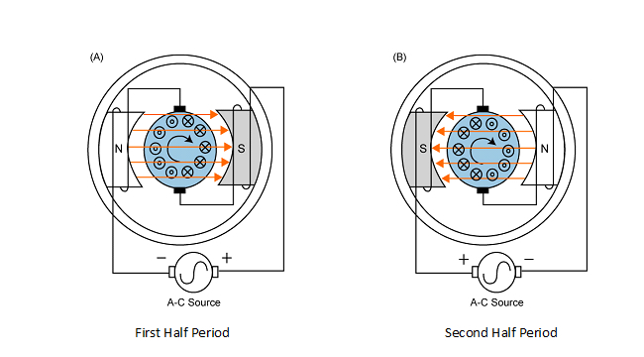
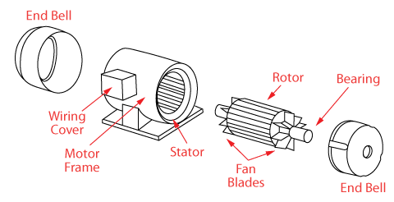
AC Motors
An AC motor is an electric motor driven by an alternating current. It converts alternate signal into rotational motion.

Slide 7
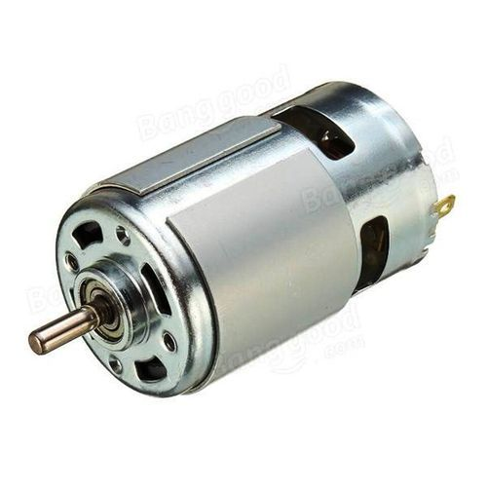
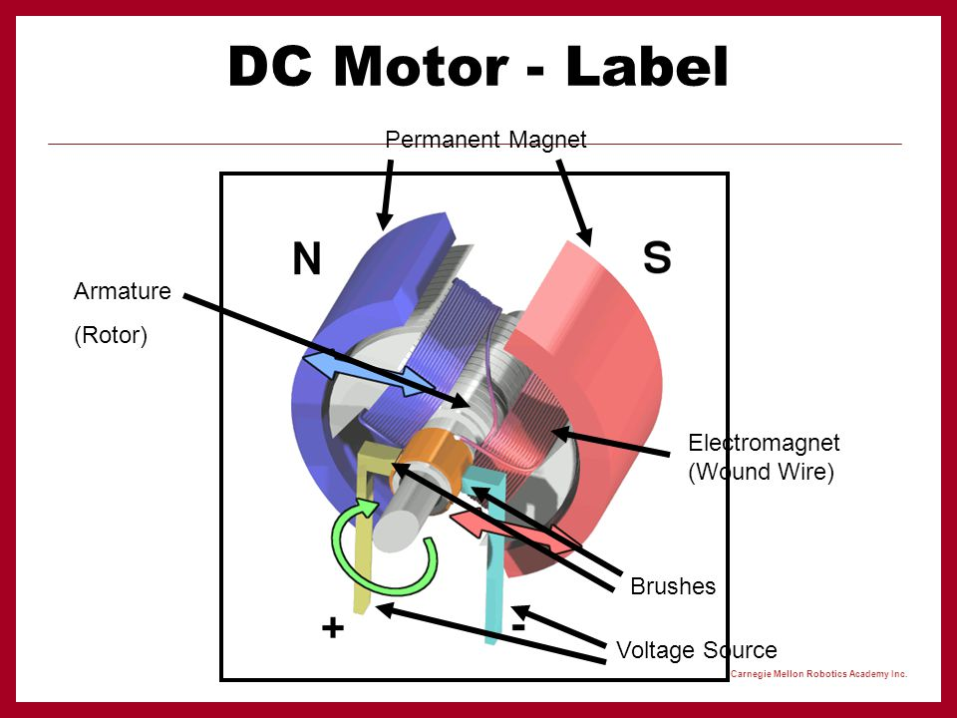
Brushed dc motors
The brushed DC electric motor generates torque directly from DC power supplied to the motor by using internal commutation, stationary magnets (permanent or electromagnets), and rotating electromagnets into rotational motion

Slide 8
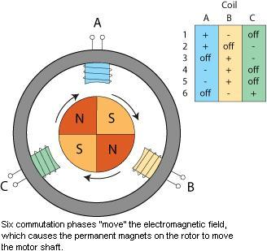
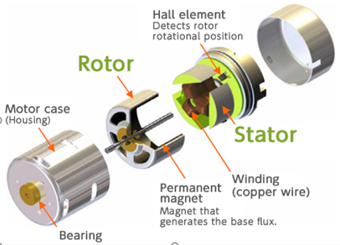
Brushless dc motors
Brushless DC electric motor are synchronous motors powered by DC electricity via an inverter or switching power supply which produces an AC electric current to drive each phase of the motor via a closed loop controller. The controller provides pulses of current to the motor windings that control the speed and torque of the motor.

Slide 9
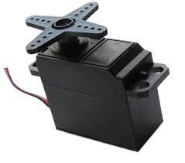
Servo motors
A servo motor is a rotary actuator or motor that allows for a precise control in terms of angular position, acceleration and velocity, capabilities that a regular motor does not have. It makes use of a regular motor and pairs it with a sensor for position feedback.

Slide 10
H-Bridge
An H bridge is an electronic circuit that enables a voltage to be applied across a load in opposite direction. These circuits are often used in robotics and other applications to allow DC motors to run forwards or backwards.

Slide 11
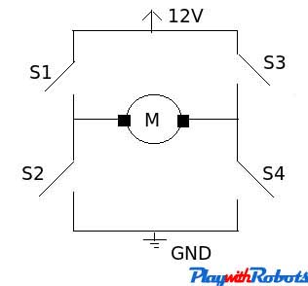
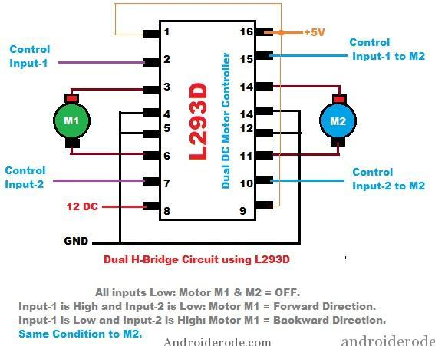
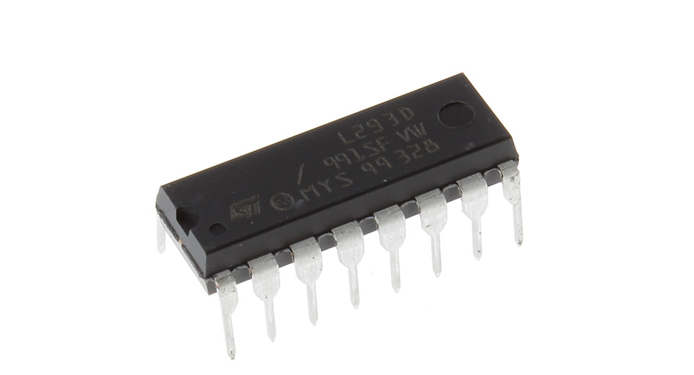
Structure of an H-Bridge Circuit

Slide 12
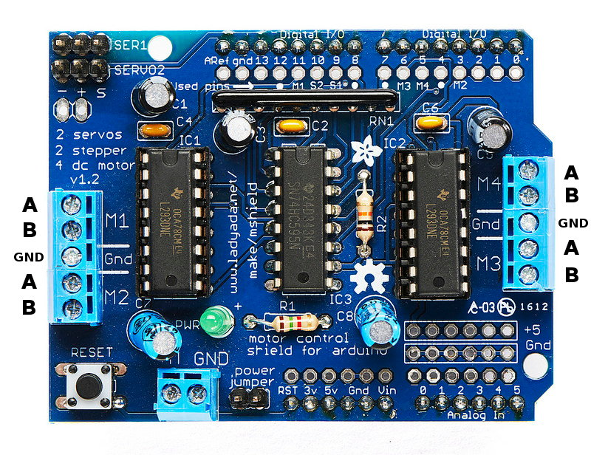
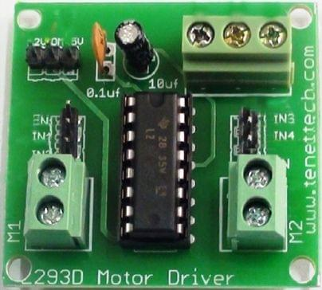
Motor Driving Circuit
There is a need of a circuitry that can act as a bridge between the above mentioned ICs and the motors.

Slide 13
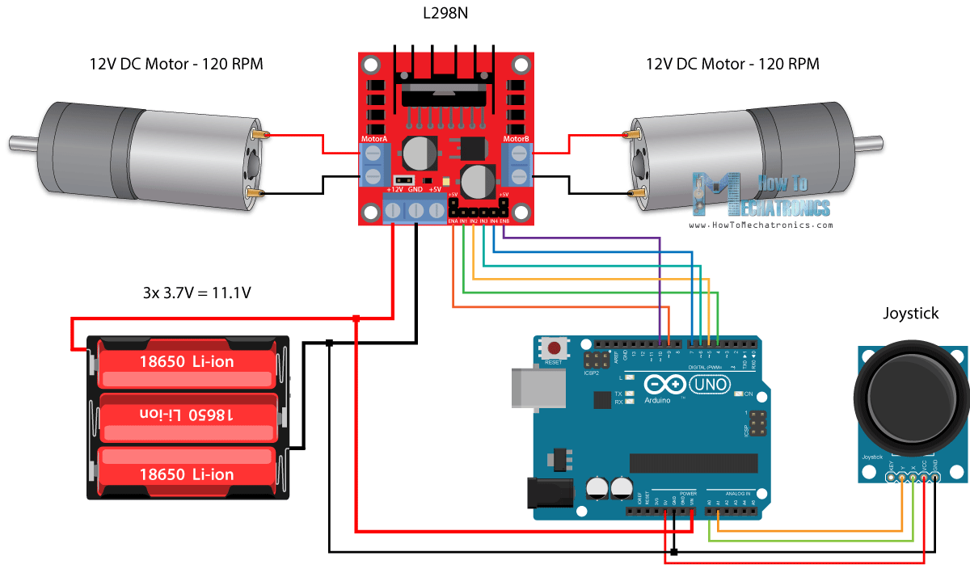
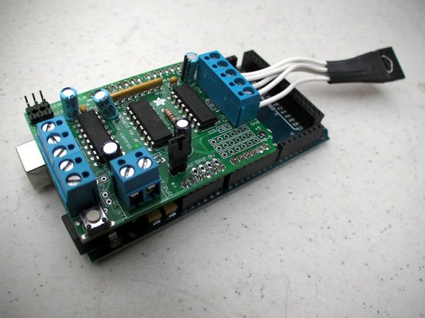
Interfacing DC Geared Motors with ARduino

Slide 14
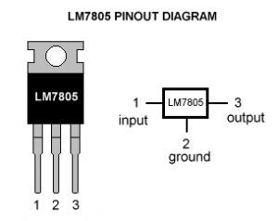
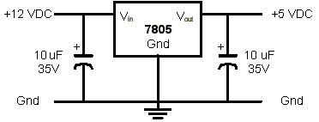
Voltage Regulator
A voltage regulator is an electronic circuit that provides a stable DC voltage independent of the load current, temperature and AC line voltage variations.

Slide 15

THANK YOU

